Slide 1
Physics-Informed Long Short-Term Memory Neural Networks for Response Prediction and Parametric Identification of Nonlinear Dynamical Systems
Author: John P. Anderson, ERAU Aerospace Engineering
Mentor: Dr. Yabin Liao, ERAU College of Engineering

Slide 2


Acknowledgements

Slide 3
Problem Statement
Closed-form solutions are often infeasible for nonlinear structural systems

Slide 4
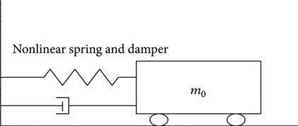





Objectives
For a Duffing spring-mass-damper system:
  ID System Parameters
  Create predictive model and compare to past work
$F$= $kx+k_{3}x^{3}+c\frac{dx}{dt}+m\frac{d^{2}x}{dt^{2}}$
$$x$$
$$k,k_{3}$$
$$F$$
$$m$$
$$c$$

Slide 5
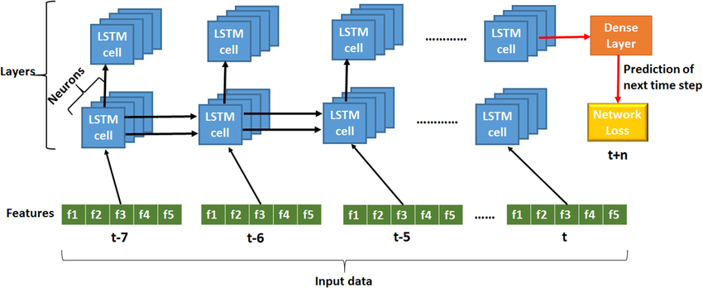
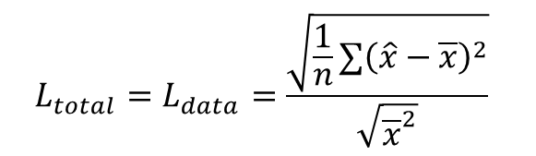
LSTM
LSTM is a discrete-time model that learns system dynamics from time-series data
  Normalized Root Mean Square Error (NRMSE)
$${L_{total}=L}_{data}=\frac{\sqrt{\frac{1}{n}∑{\left(\hat{x}−\overline{x}\right)}^{2}}}{\sqrt{{\overline{x}}^{2}}}$$

Slide 6

PI-LSTM
PI-LSTM is a LSTM model that enforces physics during training to improve predictions and consistency
$$L_{phys}=\frac{1}{n}∑{\left(F\left(t\right)−\left(k\hat{x}+k_{3}{\hat{x}}^{3}+c\frac{d\hat{x}}{dt}+m\frac{d^{2}\hat{x}}{dt^{2}}\right)\right)}^{2}$$
$$L_{total}=L_{data}+λ_{phys}L_{phys}$$
Physics Loss weight

Slide 7
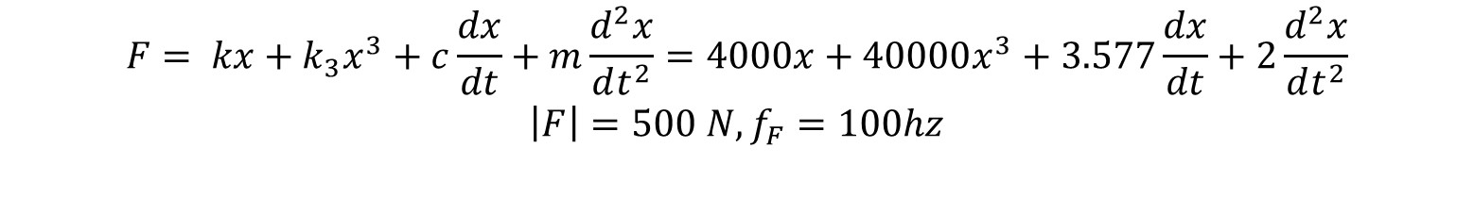
Data Generation
$$F= kx+k_{3}x^{3}+c\frac{dx}{dt}+m\frac{d^{2}x}{dt^{2}}=4000x+40000x^{3}+3.577\frac{dx}{dt}+2\frac{d^{2}x}{dt^{2}}$$
$$\left|F\right|=500 N, f_{F}=100hz$$

Slide 8
Parameter ID Results

Slide 9
Prediction and Comparison to Past Work

Slide 10
Conclusions and Real-World Applications
Parameters solved accurately: <15% (c), <1% (k), <2% (k₃)
Prediction NRMSE reduced from 0.5977 to 0.1813
PI-LSTM has potential applications in dynamical modeling and testing by providing alternatives to traditional methods

